Slide 1
Restaurant Ratings & Order Trends Analysis
ZOMATO | SQL + POWER BI PROJECT
Turning order, customer, restaurant and review data into interactive dashboards using MySQL and Power BI
Presented by Gayathri
Anudip Foundation • Course: DBA_AI
Notes:
Good morning. My project is Zomato Restaurant Ratings and Order Trends Analysis. I used MySQL for database preparation and SQL analysis, and Power BI Desktop to build interactive dashboards that explore orders, customer segments, restaurant ratings, reviews and delivery indicators.

Slide 2










Project Overview
Industry
Tools & Technologies
Food delivery and restaurant marketplace analytics
MySQL
SQL
Real-world problem
Database: zomato_analytics
Cleaning and analysis
Order, customer, restaurant and review data are hard to assess together
Purpose
Power BI Desktop
Power Query
Compare operational and customer-facing indicators in one place
Report and dashboards
Import and transformation
Approach
DAX
CSV files
MySQL for storage and SQL analysis; Power BI for modeling, DAX and dashboards
Measures and date table
Four source datasets
Notes:
This project is in the food-delivery and restaurant marketplace space. The real-world problem is that order, customer, restaurant and review data are difficult to look at together. I used MySQL to store and analyze the data, and Power BI to model it, create DAX measures and present the results as dashboards.

Slide 3
Problem Statement & Objectives
Project Objectives
Problem Statement
1
Prepare and analyze multi-table data using SQL
Bring order, customer, restaurant and review information into a single analytical workflow. By preparing data in MySQL and visualizing it in Power BI, the report helps explore order trends, delivery indicators, customer segments and restaurant ratings.
2
Build a relational data model in Power BI
3
Create DAX measures for orders, value, delivery and customers
4
Design interactive dashboards for orders, customers, ratings and locations
Analysis is descriptive: it shows patterns, not cause and effect.
5
Summarize insights and suggest follow-up actions
Notes:
The problem statement is to bring the four data domains into one analytical workflow. My objectives were to prepare and analyze the data with SQL, build a Power BI data model, create DAX measures, design interactive dashboards and summarize the insights. The analysis is descriptive, so I do not claim cause and effect.

Slide 4






Business Questions We Set Out to Answer
Volume & value
Order status
City, time & segment
How many orders are recorded and what is their total order value?
How are orders split between Delivered, Cancelled and Returned?
How do order volumes vary by city, hour and customer segment?
Delivery & basket size
Customers
Ratings & cuisine
What are the average order value and average delivery time?
How are customers spread across New, Regular and Frequent segments?
Which restaurants rate highest, and how do cuisines and reviews compare?
Notes:
These six groups of questions guided every SQL query and every dashboard page: volume and value, order status, city, time and segment patterns, delivery and basket size, customer segments, and ratings with cuisine and review comparisons.

Slide 5
Dataset Overview
customers.csv
orders.csv
restaurants.csv
reviews.csv
900
12,000
250
4,300
rows • 4 columns
rows • 10 columns
rows • 11 columns
rows • 6 columns
customer_id, customer_city, signup_date, customer_segment
order_id, customer_id, restaurant_id, order_date, order_time, order_amount, delivery_time_mins, order_status …
restaurant_id, restaurant_name, city, primary_cuisine, restaurant_rating, online_delivery …
review_id, restaurant_id, customer_id, review_date, rating, review_text
17,450 rows • 31 columns across four CSV files loaded into the MySQL database zomato_analytics (practice dataset)
Notes:
The data comes from four CSV files: customers with 900 rows, orders with 12,000 rows, restaurants with 250 rows and reviews with 4,300 rows. Together that is 17,450 rows and 31 columns. These are per-file counts, not unique entities. This is a project or practice dataset, so I do not present it as official Zomato business records.

Slide 6





Project Workflow
1
2
3
4
5
Industry Selection
Problem Identification
Dataset Collection
MySQL Database Setup
Cleaning & Transformation
Food delivery marketplace
Scattered order and review data
Four CSV files
zomato_analytics
Using SQL
6
7
8
9
Result
5-page interactive Power BI report
SQL Data Analysis
Power BI Data Modeling
Dashboard Development
Insights & Recommendations
Aggregations and joins
Relationships and DAX
Five report pages
Findings and next steps
Notes:
The workflow runs from industry selection and problem identification, to collecting the CSV files, setting up the MySQL database, cleaning and transforming with SQL, analyzing with SQL, modeling in Power BI, building the dashboards and finally writing insights and recommendations. The result is a five-page interactive report.

Slide 7

MySQL Database & SQL Analysis
Setup
Order status summary
CREATE DATABASE / CREATE TABLE for four tables
SELECT order_status,
COUNT(*) AS order_count,
SUM(order_amount) AS total_order_value
FROM orders
GROUP BY order_status
ORDER BY order_count DESC;
Import
Load CSV rows into MySQL
Inspect & filter
SELECT, WHERE, ORDER BY, LIMIT
Top 10 restaurants by order value (JOIN)
KPIs
SELECT r.restaurant_name,
SUM(o.order_amount) AS total_value,
COUNT(DISTINCT o.order_id) AS total_orders
FROM orders AS o
JOIN restaurants AS r
ON o.restaurant_id = r.restaurant_id
GROUP BY r.restaurant_name
ORDER BY total_value DESC
LIMIT 10;
COUNT, SUM, AVG aggregates
Summaries
GROUP BY status, city, cuisine, segment
Combine tables
JOIN on customer_id and restaurant_id
Notes:
In MySQL I created the zomato_analytics database and loaded the four CSV files. I used SELECT with filters, aggregate functions such as COUNT, SUM and AVG, GROUP BY for summaries and JOINs on customer_id and restaurant_id. The first query summarizes orders and order value by status. The second joins orders to restaurants to rank the top ten restaurants by order value. Only include in your talk the statements that are in your own SQL file.

Slide 8

Power BI Data Preparation & Model
Import
customers
dimension
restaurants
dimension
Load from MySQL or the prepared CSV files
Set data types
IDs as identifiers, amounts as decimals, dates and times as Date/Time
restaurant_id
orders
fact table
Clean in Power Query
customer_id
Check blanks and inconsistent labels; keep raw data unchanged
order date
Model
DimDate
calendar table
reviews
ratings and text
One-to-many relationships plus a date table
Reviews also link to customers through customer_id
Notes:
In Power Query I imported the data, set the correct data types and checked blanks and inconsistent labels while keeping the raw source unchanged. In the model, orders is the central fact table connected to customers and restaurants by customer_id and restaurant_id, and a DimDate calendar table connects to the order date. Reviews connect to restaurants and customers.

Slide 9
DAX Measures
Total Orders
Total Order Value
Cancellation Rate %
DISTINCTCOUNT(
orders[order_id])
SUM(
orders[order_amount])
DIVIDE(
[Cancelled Orders],
[Total Orders], 0)
Unique orders recorded
Sum of order amounts
Cancelled share of all orders
Average Order Value
Average Delivery Time
Segment Customers
DIVIDE(
[Total Order Value],
[Total Orders], 0)
AVERAGE(
orders[delivery_time_mins])
CALCULATE(
[Total Customers],
customers[customer_segment]
= "Regular")
Value per order
Mean delivery minutes
New, Regular, Frequent counts
Notes:
These DAX measures drive the KPI cards. Total Orders uses DISTINCTCOUNT on order_id. Cancellation Rate uses DIVIDE to avoid division errors. Average Order Value divides total order value by total orders. Segment customer counts use CALCULATE with a filter on customer_segment. I also created a DimDate table with CALENDAR for time-based analysis.

Slide 10
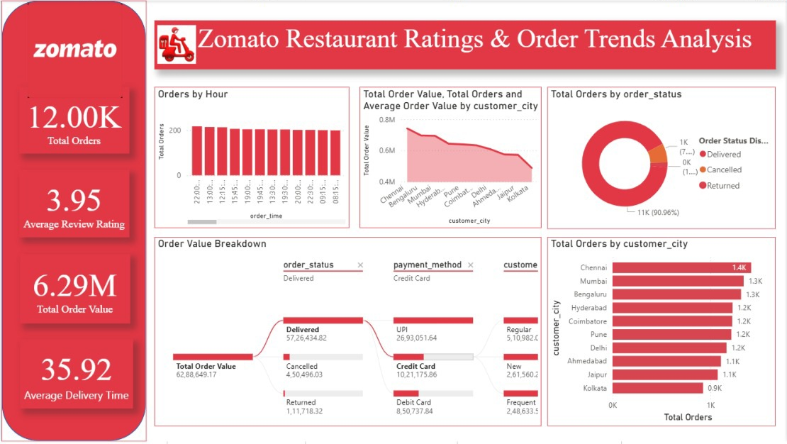
Dashboard 1: Ratings & Order Trends Overview
12.00K
3.95
Total Orders
Average Review Rating
6.29M
35.92
Total Order Value
Avg Delivery Time
Orders by hour compared across time slots
Status donut: Delivered is the largest share
Decomposition tree: value by status, payment, segment
Cities ranked by total orders
Page 1 of 5: KPI cards, order timing, status mix and city ranking
Notes:
The first page is the executive overview. The cards show about 12,000 orders, an average review rating of 3.95, a total order value of 6.29 million and an average delivery time of 35.92 minutes. Charts cover orders by hour, order status, an order value breakdown and orders by city. Validate the exact values and units before presenting them as final.

Slide 11
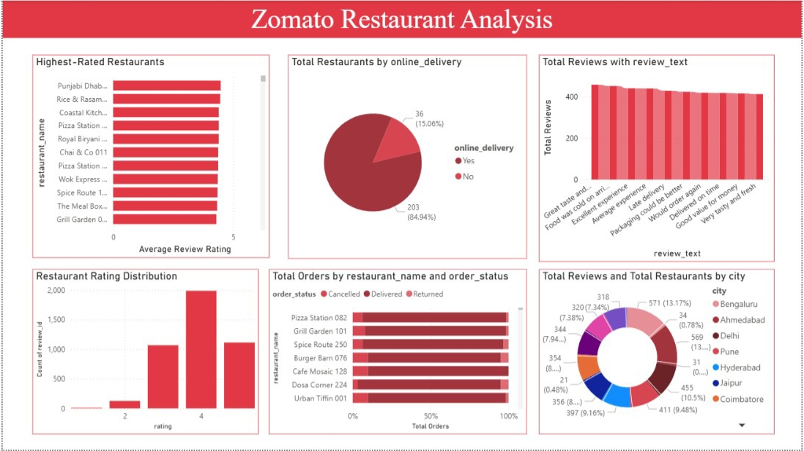
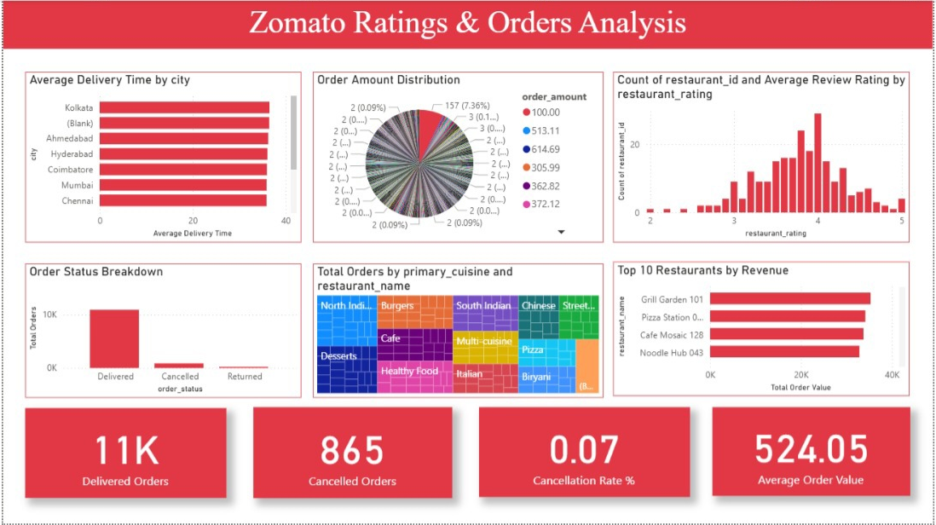
Dashboards 2 & 3: Restaurants, Ratings & Orders
Restaurant Analysis
Ratings & Orders Analysis
Highest-rated restaurants and rating distribution
Online delivery: 203 Yes vs 36 No
Reviews and restaurants by city
Delivery time by city, top 10 restaurants by value
Cuisine treemap and status breakdown
Cards: 865 cancelled orders, average order value 524.05
Notes:
Page two, Restaurant Analysis, shows the highest-rated restaurants, the rating distribution, which restaurants offer online delivery and reviews by city. Page four, Ratings and Orders Analysis, covers delivery time by city, order amount distribution, order status, a cuisine treemap and the top ten restaurants by order value, with cards for delivered orders, 865 cancelled orders, cancellation rate and average order value.

Slide 12
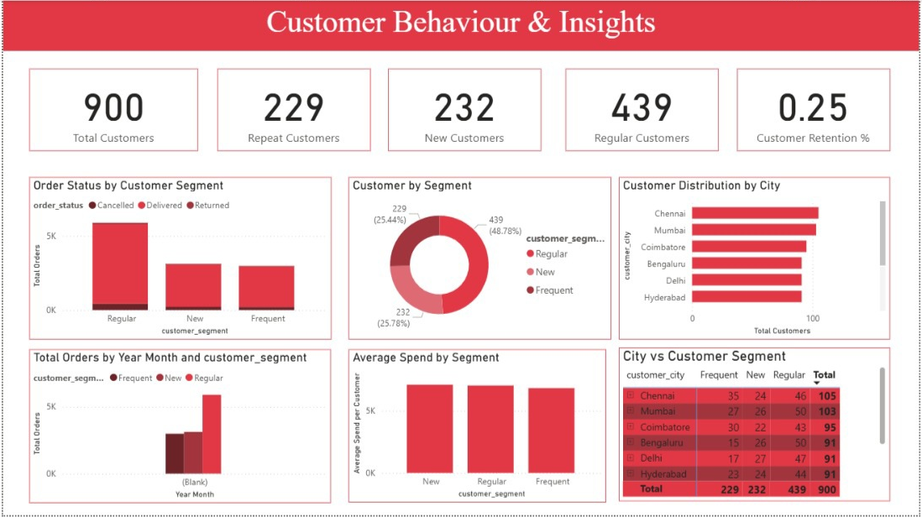
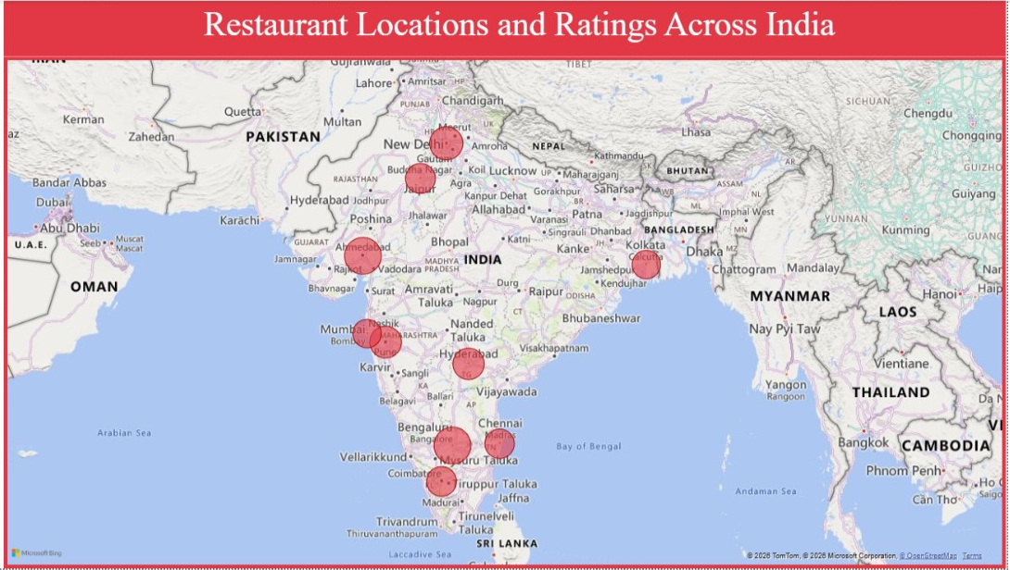
Dashboards 4 & 5: Customers and Locations
Customer Behaviour & Insights
Restaurant Locations Across India
900 customers: 439 Regular, 232 New, 229 Frequent
Customer distribution and segments by city
Average spend by segment
Bubble map of restaurant locations
Tooltips: city, reviews, rating, total orders
Geographic view of ratings and activity
Notes:
The customer page splits the 900 customers into 439 Regular, 232 New and 229 Frequent customers, and compares them by city and average spend. The map page shows restaurant locations across India as bubbles, with tooltips for city, reviews, rating and orders. Note that the monthly trend visual on the customer page should only be used after the Year Month date issue is fixed.

Slide 13
Key Insights from the Dashboards
Order value by status
Total orders by city (K)
Customers by segment
Delivered orders carry about 91% of the 6.29M total order value
Chennai leads on orders; Kolkata is lowest of the ten cities
Regular customers are the largest of the 900 (439)
Ratings cluster near 4 stars (average 3.95); 203 restaurants offer online delivery vs 36 that do not; 865 orders were cancelled (0.07 rate)
Notes:
Delivered is the largest status category and accounts for about 91 percent of order value. By city, Chennai has the most orders at about 1.4K and Kolkata the fewest at about 0.9K. Customers split into 439 Regular, 232 New and 229 Frequent. Ratings concentrate around four stars with an average of 3.95. These are descriptive observations from the dashboards; confirm exact counts before quoting percentages.

Slide 14




Challenges Faced & How We Overcame Them
Challenge
How it was addressed
(Blank) Year Month in the trend chart
Built a DimDate table, created a date-only key, kept the relationship active and sorted by YearMonthSort
Hours and months sorted alphabetically
Used a sort-by-column field so time labels follow chronological order
KPI definitions: Repeat vs Frequent, retention 0.25, cancellation 0.07
Kept one segment definition, used DIVIDE with the correct denominator and applied percentage formatting
Crowded visuals: order amounts and review text
Replaced with bins or histograms and used Top N filters with shorter labels
Source, currency and metric validation
Matched Power BI totals with SQL results and labeled the data as practice data with units unconfirmed
Notes:
These are the main challenges documented in the project. The Year Month field showed blank values, which I addressed with a proper date table and relationship. Time labels were sorting alphabetically, so I used sort-by-column fields. KPI definitions such as Repeat versus Frequent customers, retention and cancellation rate needed consistent definitions and formatting. Charts with too many categories were replaced with bins or Top N. Finally, I validated Power BI totals against SQL and described the dataset honestly as practice data. Adjust this slide to match the fixes you actually applied.

Slide 15
Conclusion
Key Takeaways
MySQL and Power BI combined into one analytical workflow
Five dashboard pages compare orders, customers, ratings and locations
Delivered orders dominate; cancellations and returns are small but worth tracking
Findings are descriptive and need validated sources and units
Deliverables on GitHub: PBIX report • SQL script • four CSV datasets • dashboard screenshots • README
Thank you
Notes:
To conclude, the dashboards make it easier to compare order status, customer segments, restaurant ratings and city-level patterns. Before operational decisions, the dataset source, date relationships, KPI definitions and metric units should be validated. Thank you.

